Slide 1
Veille projet_immo

Slide 2
Imputation des données manquantes

Slide 3
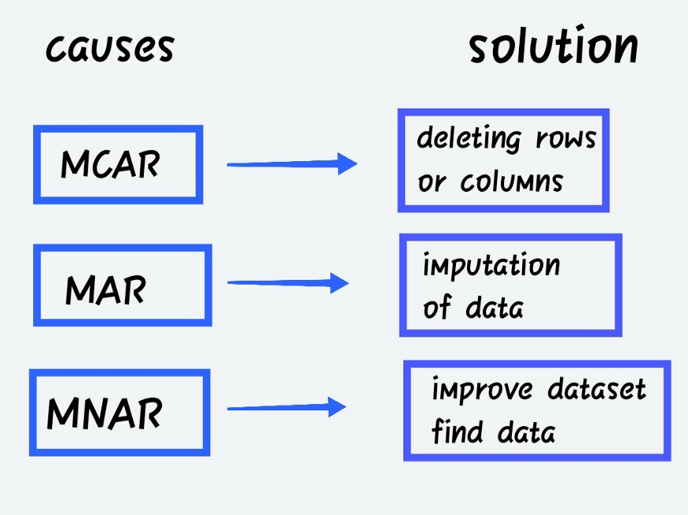

Slide 4
Type d’imputation
https://towardsdatascience.com/imputing-missing-data-with-simple-and-advanced-techniques-f5c7b157fb87
https://www.analyticsvidhya.com/blog/2021/10/a-complete-guide-to-dealing-with-missing-values-in-python/

